Slide 1
The Wrapup
YOU MADE IT

Slide 2
Best Practices
Now that you’re an official coder, you should be aware of Best Practices
ADF&G Best Practice Guide – Contains practical tips!

Slide 3
Matt & Justin’s Top 10 Tips
1) Practice, practice, practice
2) Ask for help!
3) Go slow, be thorough
4) Build for the future
5) Comment HEAVILY
6) Pseudocode is the best code
7) Generalize & modularize
8) Be patient (with yourself)
9) Celebrate the wins!
10) Build something fun for you
Notes:
Give yourself grace
Build something fun for you

Slide 4
What’s next?!
You now know the basics of R! If you want to be successful, you will need to keep practicing.
Review / complete assignments
Work on your OWN R project!
Email Matt and/or Justin
Next week Next Month 6 Months
Review presentation Practice coding
Re-visit presentations

Slide 5
Parting Thoughts
Like any language, becoming familiar with R requires a little practice over a long period of time. It’s easy to get discouraged initially.
Keep googling your problems: it’s very unlikely that you’re the first with this issue. I still google how to do something almost every other line of code.
Programming is not the same as asking the right questions: learn more statistics! It is possible that you are attempting analysis that is best accomplished differently. Or worse, doing something you shouldn’t.
Notes:
However, unlike spoken languages, you can take your time! It took me 10 minutes to write a line of code before. It’s OK to go slow.
For me, the best way to motivate myself to learn was having my own dataset to work through; for others, online tutorials were best.
Even the best programmers still google and read Stack Exchange.

Slide 6

Congrats!
This certificate is good for a free R help session, one-on-one!
Plus, you’re always welcome to ask one of us for help; the worst we can say is “I’m busy”
Notes:
We really enjoy helping people with their R questions. Please message us

Slide 7
Resources
Just Starting Out – Teach yourself!
https://datacarpentry.org/R-ecology-lesson/00-before-we-start.html
Learnr tutorial about NAs
Learnr tutorial about filtering
Learnr tutorial about summarizing
https://r-bootcamp.netlify.app/
https://rstudio.cloud/learn/primers
https://ggplot-dplyr-intro.netlify.app/
Just Starting Out - Comprehensive
In-depth Resource 1
In-depth Resource 2
Similar layout to class!

Slide 8
Resources
Data Management
Data Organization in Spreadsheets
https://annebeaudreau.com/2018/02/04/data-management-tips/
Workflow
https://whattheyforgot.org/project-oriented-workflow.html
https://www.tidyverse.org/articles/2017/12/workflow-vs-script/

Slide 9
Resources
Style Guides
http://r-pkgs.had.co.nz/style.html
https://google.github.io/styleguide/Rguide.xml
Statistics
http://www.shinystats.org/
https://seeing-theory.brown.edu/regression-analysis/index.html

Slide 10
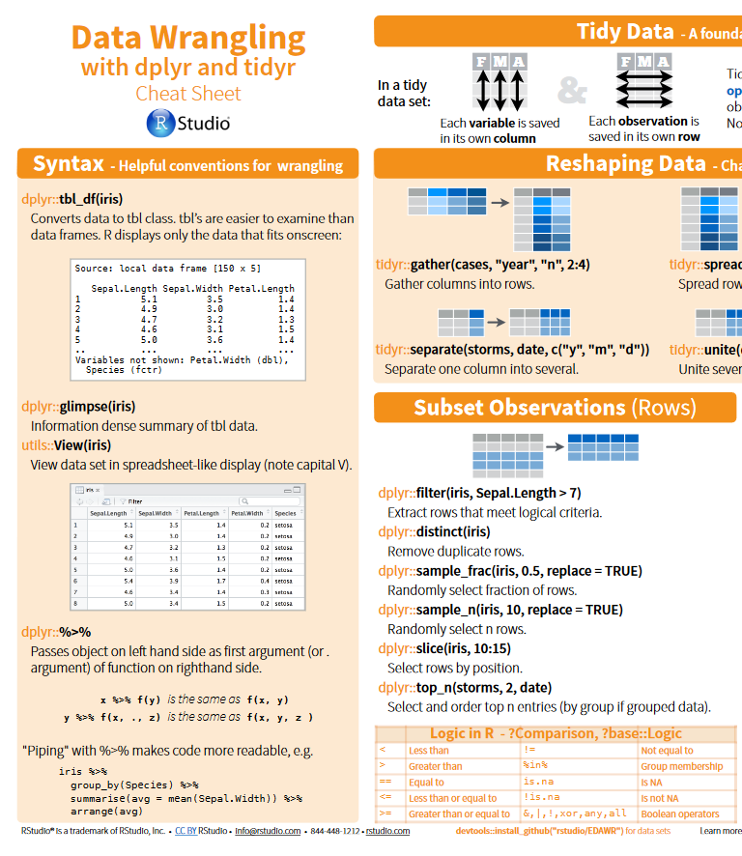
Cheatsheets
All cheatsheets
Getting started
dplyr and tidyr
Data import
lubridate
ggplot2
RStudio

Slide 11
Special Thanks
People who have taught, helped, or inspired us, or whose code we’ve have shamelessly copied and learned from:
Justin:
Franz Mueter (UAF)
Ben Williams (NOAA/ADF&G)
Jordan Watson (NOAA)
Curry Cunningham (UAF)
Jenny Bryan (UBC)
Hadley Wickham (RStudio)
Allison Horst (RStudio)
Rhea Ehresmann (ADF&G)
Adam Reimer (ADF&G)
Matt:
Megan Higgs (MSU)
Jim Robison-Cox (MSU)
Hadley Wickham (RStudio)
Yihui Xie (RStudio)
Mike Boyd (Youtube)
Grant Sanderson (Youtube)
Adam Reimer (ADF&G)

